Slide 1
Smart Drive System Submitted By: Mostafa Mahmoud Taha Khaled Adel Hani Soaad Ali Mariam Adel Dina Gamal-Eldin Supervised By: Eng:Omar Osman

Slide 2
Content:
Features
Modes
Layers Architecture
Project Components
Idle Mode
High Speed Mode
Low Speed Mode
Main
GUI

Slide 3
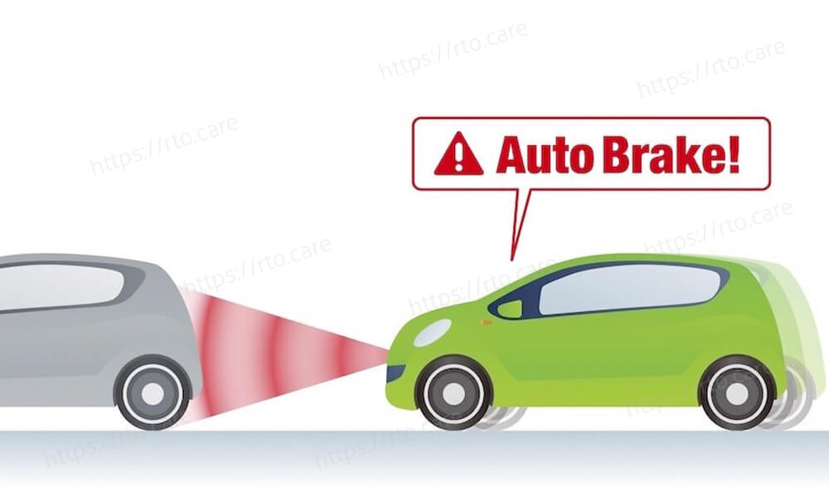
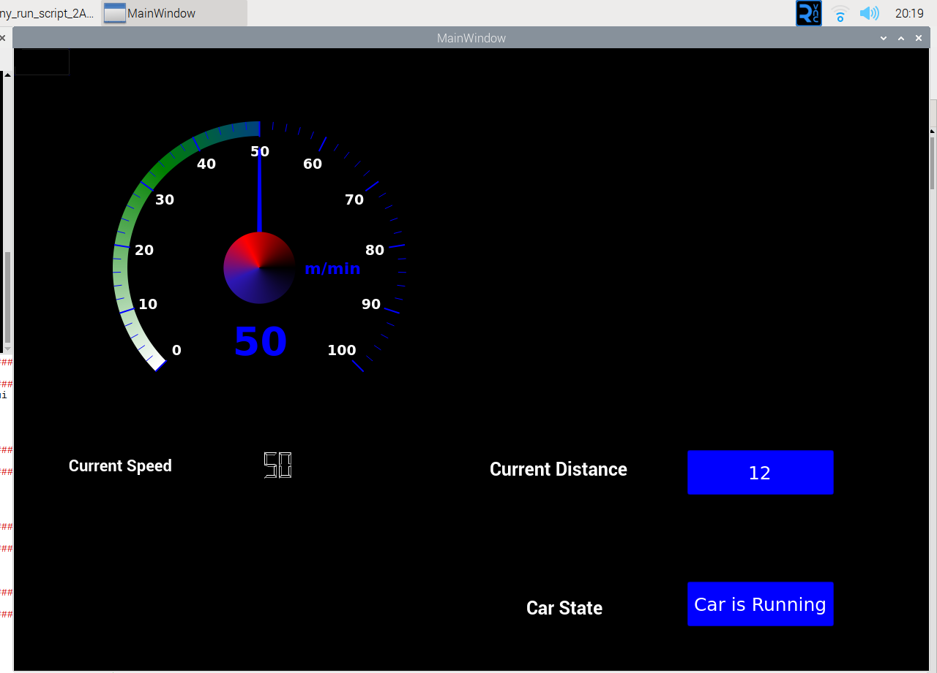
Features:
1. ACC (Adaptive Cruise Control) 2. LDW (Lane Departure Warning) 3. AEB (Automated Emergency Braking)
4. LKS (Lane Keeping Support). 5.GUI

Slide 4
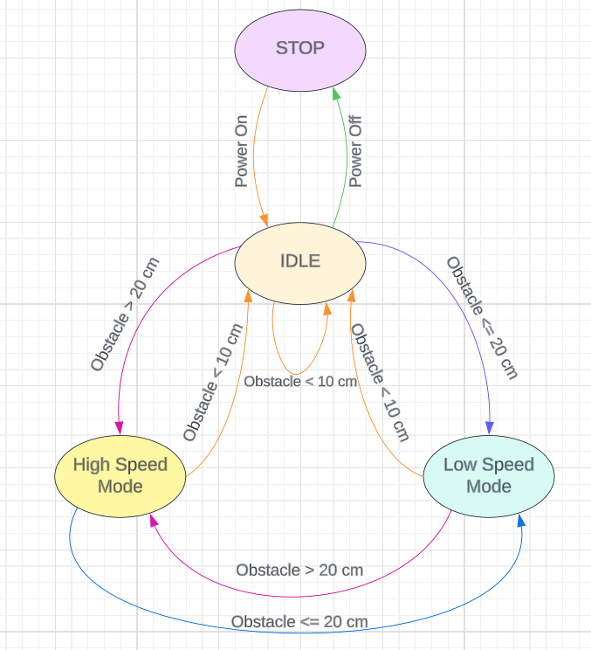
Modes
Stop Mode
Idle Mode
High Speed Mode
Low Speed Mode

Slide 5
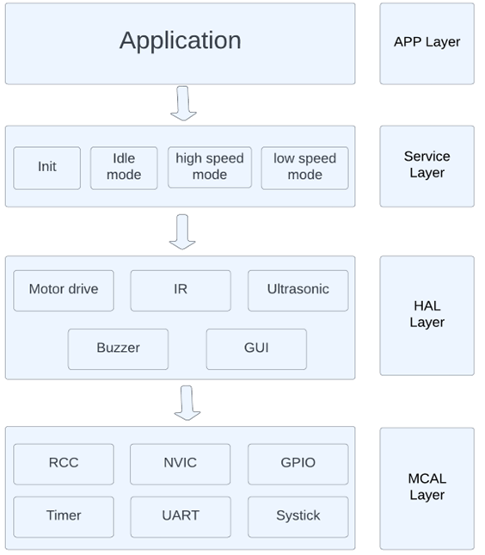
Layers architecture:-

Slide 6
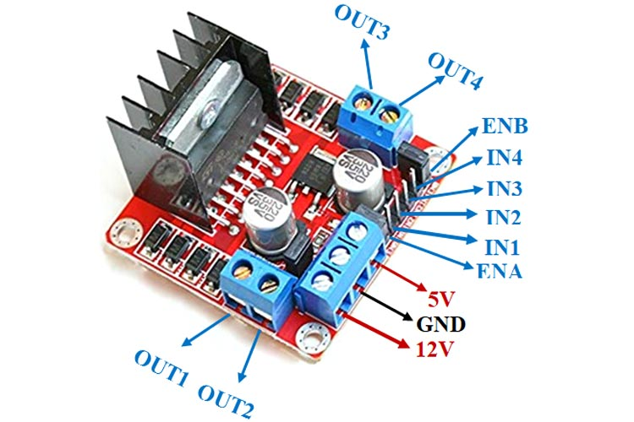
Project components:- -Motor driver (l298N)
The L298N is a popular dual H-bridge motor driver integrated circuit (IC) commonly used in robotics and automation projects. It allows you to control the direction and speed of two DC motors or a single stepper motor.

Slide 7
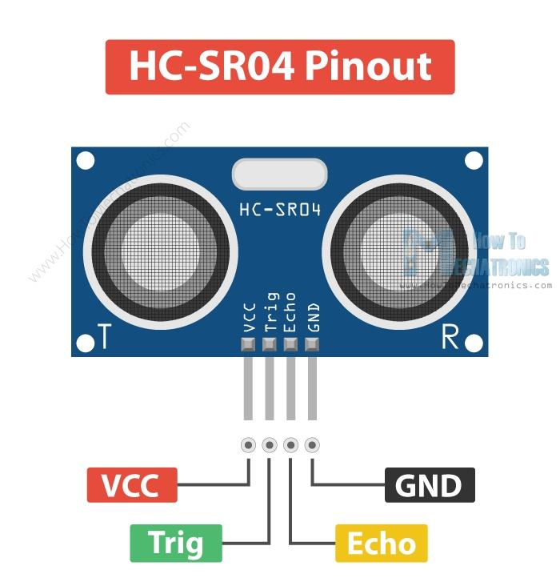
-Ultrasonic sensor (HCSR04)
The HC-SR04 is an ultrasonic distance sensor that is commonly used in robotics and automation projects to measure distances.
Distance Calculation:
Distance = (Speed of Sound × TOF) / 2.

Slide 8
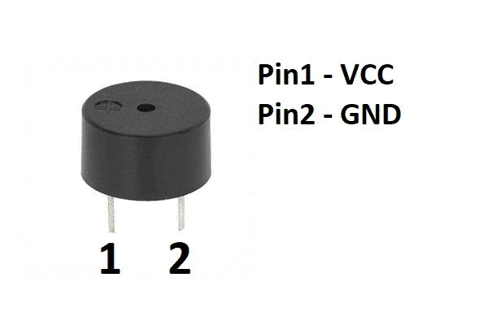
-Buzzer
A buzzer is a simple electronic device that generates sound or an audible tone when an electrical signal is applied to it.

Slide 9
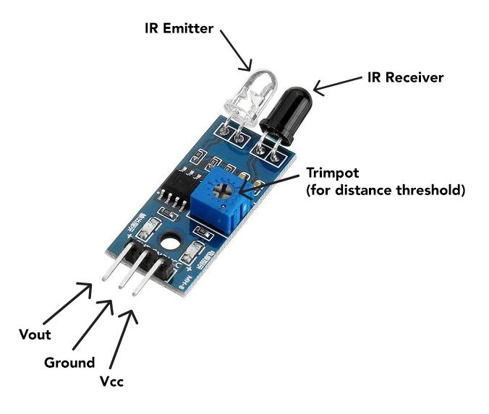
-IR sensor
IR (infrared) sensors, also known as IR detectors or IR receivers, are electronic devices that can detect and measure infrared radiation emitted by objects.

Slide 10
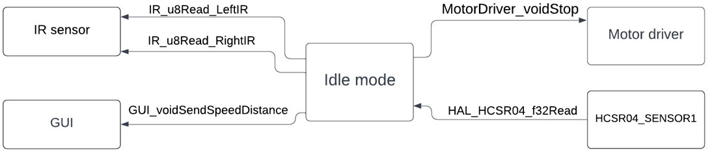
Idle Mode Component diagram:-

Slide 11
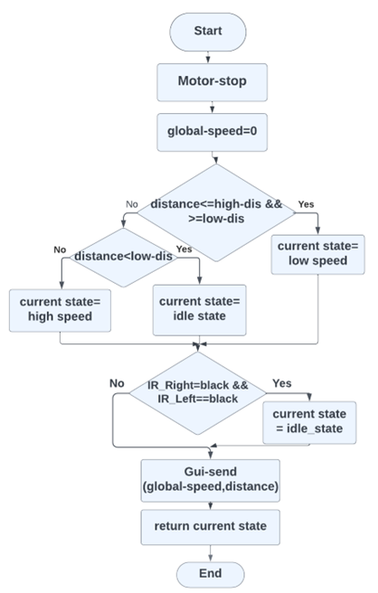
Activity Diagram:-

Slide 12
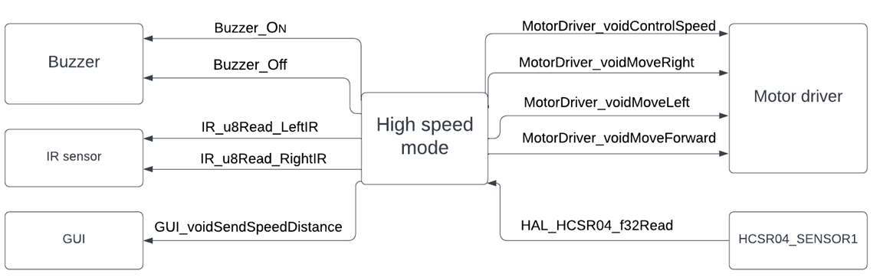
High Speed Mode
Component diagram:-

Slide 13
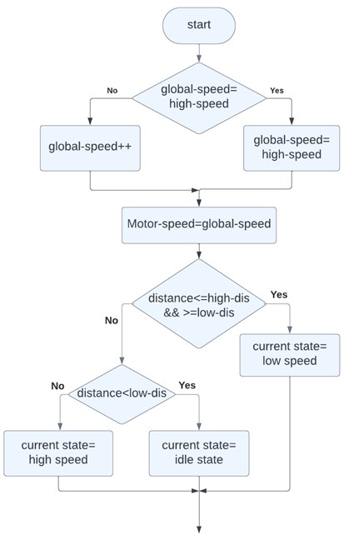
Activity Diagram:-

Slide 14
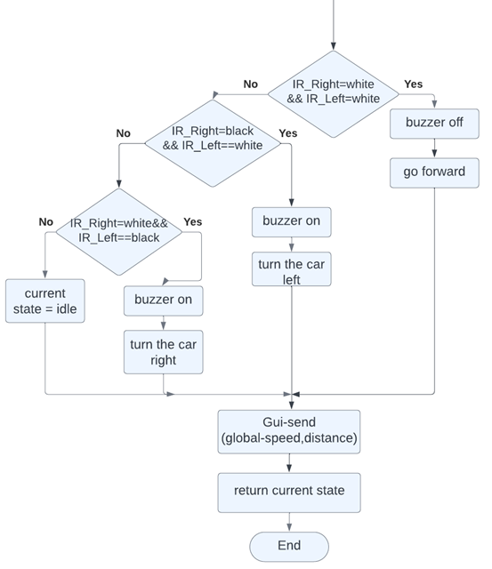

Slide 15
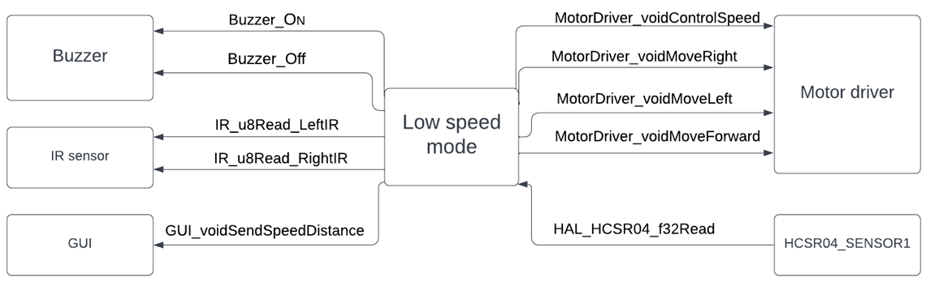
Low Speed Mode
Component diagram:-

Slide 16
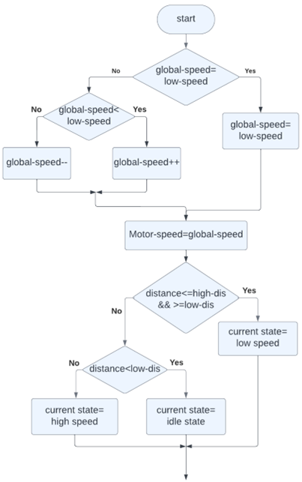
Activity Diagram:-

Slide 18
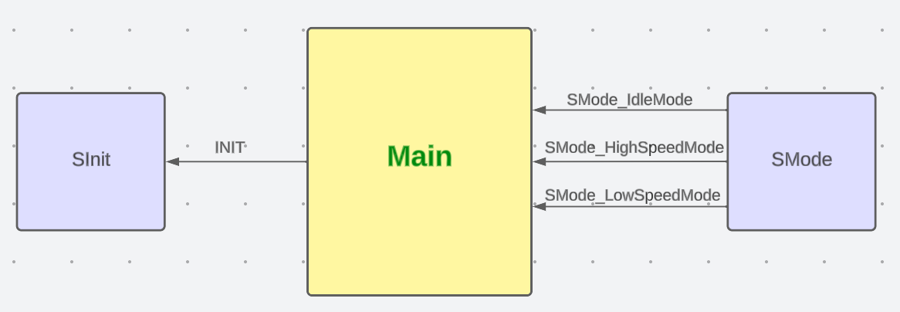
Main
component diagram:-

Slide 19
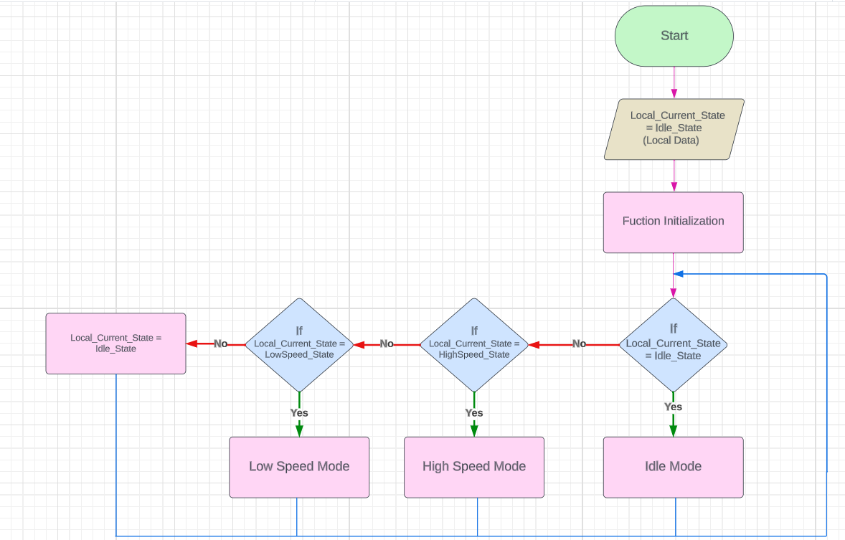
Activity diagram:-

Slide 20
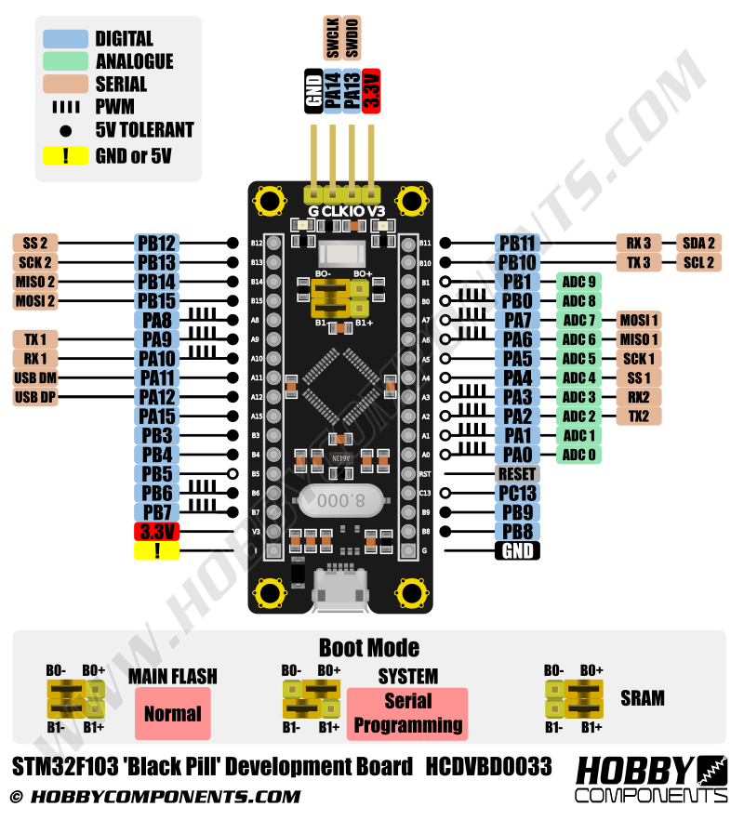
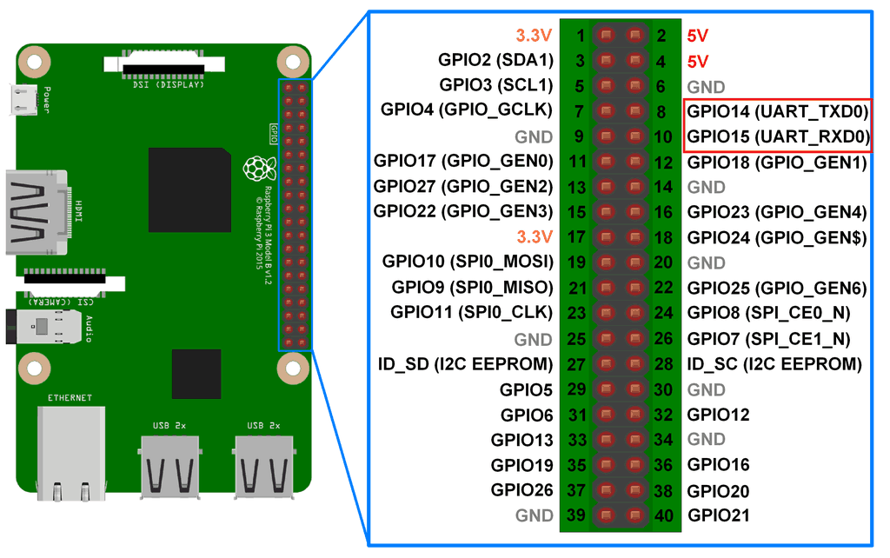
Connect Raspberrypi with STM32 using UART communication

Slide 21
GUI

